Slide 1
Synchronous Job Submission Workflow
Start
Parse response to find if any job is running
Make API call for list of models
Job running?
No
Parse response and prepare a list of ONLINE model names
Make submit job API call for the model from the list of models
Yes
Job for all models submitted?
Yes
Is last job completed?
No
Make API call for list of jobs
Pause for some time(1 minute)
No
Yes
End

Slide 2
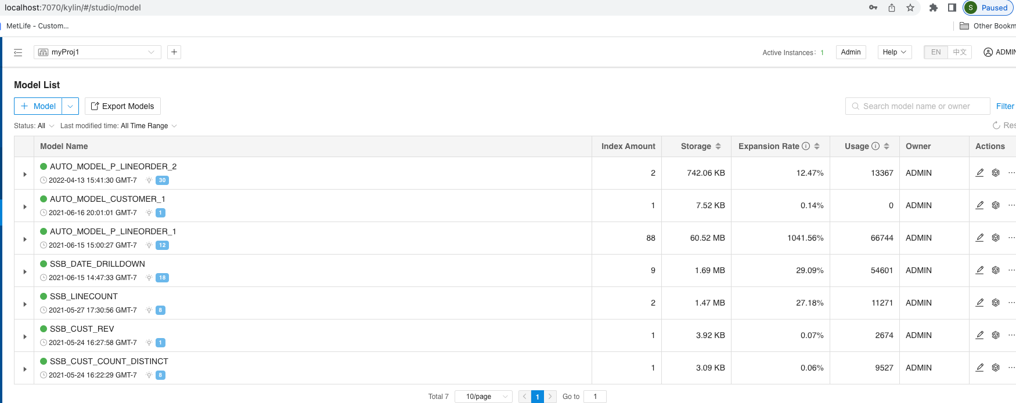
List of models in the project

Slide 3
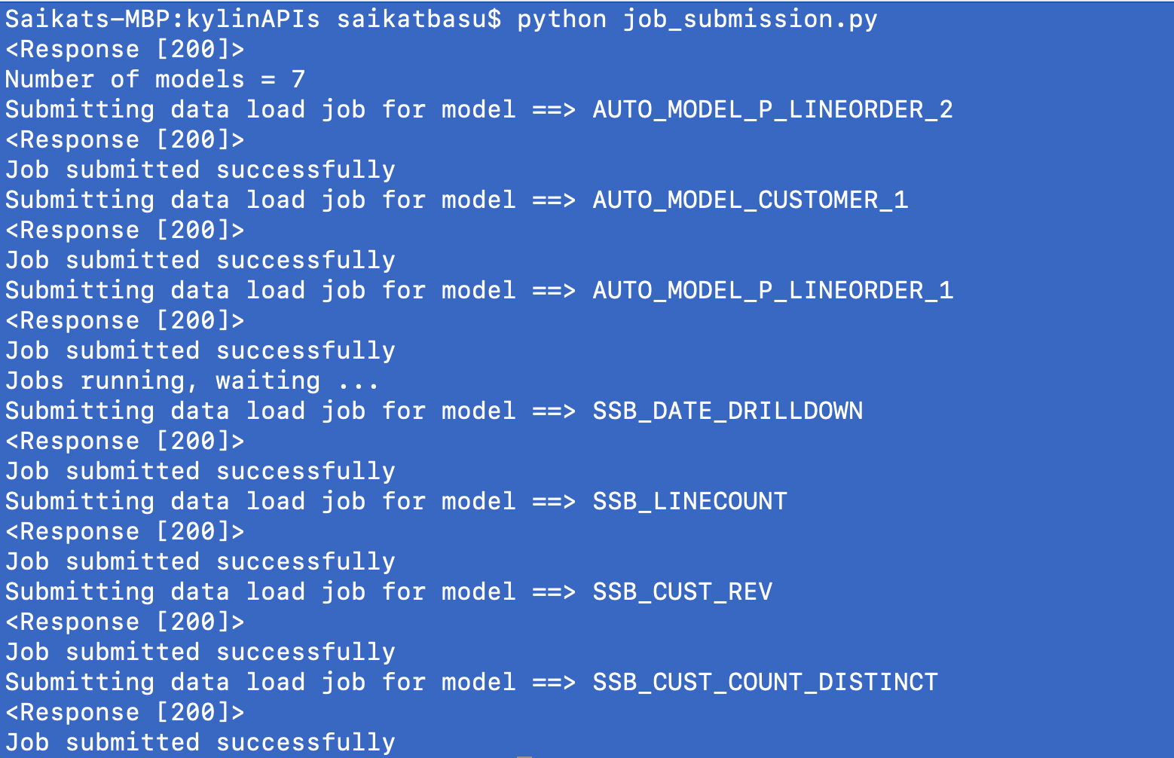
Program output for synchronous job submission

Slide 4
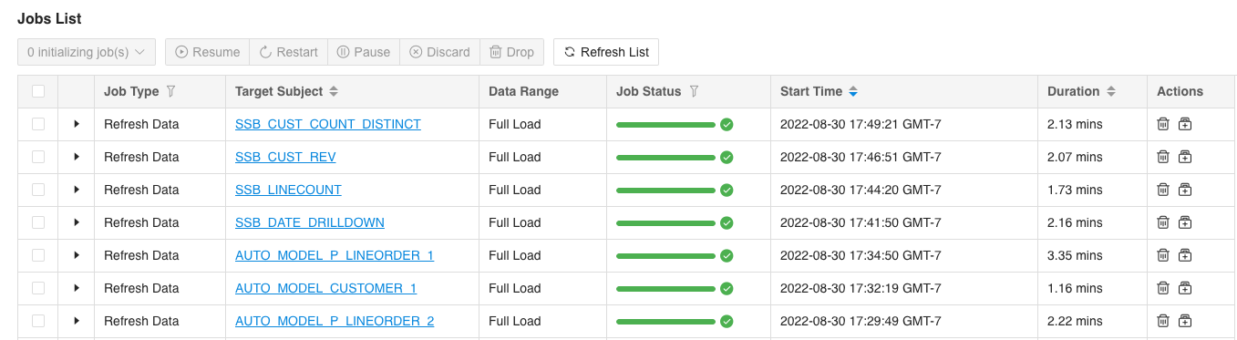
Job submission UI showing submission of 1 job at a time
+
+

